Slide 1
How do we Make Decisions That are Both Morally and Scientifically Informed?
Mount Notre Dame HS

Slide 2

Formative assessment: Student Activity: Ten Scenarios
(See document)
Read the 10 scenarios and
decide if you Agree or Disagree?
This Photo by Unknown Author is licensed under CC BY-NC-ND

Slide 3
TOPIC: How does morality and the nature of science intersect as they inform the decisions we make for the common good?
Why did you pick the answer you did?
Did the source of the information affect your decision?
Did you factor in or consider others when making your decision?
What would change your decision? For example, would a strong opinion from your dentist convince you to change your decision (if you don’t floss every day)?

Slide 4

Relationship of science and ethics – A fundamental misunderstanding
The Myth of the faith/science conflict
Faith and reason are like two wings on which the human spirit rises to the contemplation of truth; and God has placed in the human heart a desire to know the truth- in a word, to know himself- so that, by knowing and loving God, men and women may also come to the fullness of truth about themselves.” - Pope St. John Paul II
Catholic thinkers and theologians have always been deeply invested in and interested in science. It’s the beautiful complex creation that God has given us…we want to understand it!
Examples of Catholic scientists
https://www.catholicscientists.org/catholic-scientists-of-the-past
https://en.wikipedia.org/wiki/List_of_Catholic_clergy_scientists
This Photo by Unknown Author is licensed under CC BY-SA

Slide 5

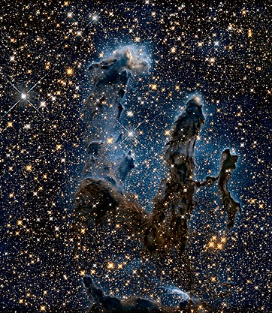
By looking around at creation, reason and experience can point to God’s existence (CCC, nos. 156-159).
The study of the world through the experience of doing science is an opportunity for us to be struck by the wonder at the complexity of it.
What do the two have to do with one another as it relates to decision making?
This Photo by Unknown Author is licensed under CC BY-SA

Slide 6
Ethical decisions involve science, values, morals, as well as the consideration of the common good. We will look at some examples today.
Nature of Science - Science approaches every investigation through the scientific method. This approach will yield information which can be used to formulate decisions.
Values--what you feel is important when making a decision ex. cost, environmental impact, aesthetics
Morals--how you use your values when making a decision
Ethics--how you work through problems to determine the best course of action

Slide 7
The common good
The Common Good - From the Catechism, the common good is the “sum total of social conditions that allow people, either as groups or individuals, to reach their fulfillment more fully and more easily.”
The common good requires that individuals and societies
1 – respect the basic, inalienable rights of each human being
2 – promote the social well-being and development of various social groups
We must consider the effect of our decisions on OTHERS in our communities (both loved ones, acquaintances, AND strangers)

Slide 8

Catholic social teaching
To keep the common good in the forefront of our decision making, we must be familiar with the Catholic Social Teachings. Let’s review the 7 themes:
https://www.usccb.org/beliefs-and-teachings/what-we-believe/catholic-social-teaching/seven-themes-of-catholic-social-teaching
This Photo by Unknown Author is licensed under CC BY-SA-NC

Slide 9
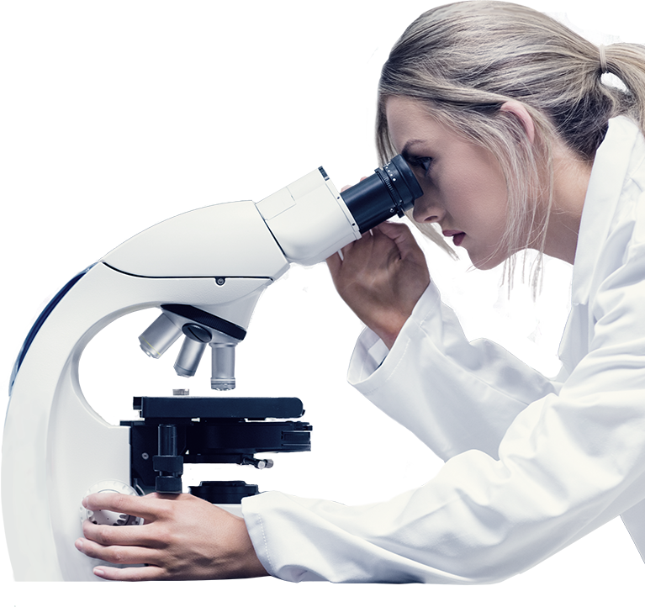
Science can help inform moral principles or the application of moral principles by offering data that can be analyzed in conjunction with these principles
Science and religion can work together (science = how and religion = why)
HOW: research, data
WHY: as a moral person, how you act with the information, motivations for your decision
This Photo by Unknown Author is licensed under CC BY-NC

Slide 10
Consider these questions when making an ethical/moral decisions:
How do we find the known facts? How do we know those facts are true? What evidence would you look for to support the facts?
Who would you consult for more information? Professionals? Trusted counsel? Spiritual counsel? Why?
How do you assess people’s motives, intentions, and values?
What is the right personal code of ethics when considering the Common Good?
When we consider our faith, do we use religious tradition (ie. church documents, the Catechism, or scripture?
We can also apply cardinal virtues to help guide us: Prudence (it is prudent to keep yourself informed), Wisdom (seek wisdom of those who know the situation well), Fortitude (have the courage to make right decisions), Temperance (sacrifice by individuals is often required for the common good). Can you provide an example of your use of a Cardinal virtue over the last year?
Once we decide on a course of action, how should we weigh the consequences of our decisions and their effect on others?
How does your guide demonstrate the value of solidarity from Catholic Social Teaching?

Slide 11
Longer Scenarios – Scenario 1
Early in the COVID-19 pandemic, the CDC recommended that hand washing several times daily is essential to preventing the spread of the disease. Indoor congregations of groups indoors (such as for religious services, weddings, funerals, sporting events, in-person school) were also banned to avoid the spread of COVID-19.
For those that did comply with these bans, think of at least one inequality or injustice that occurred? For that example, why was it unfair?
For those that did not comply with these bans, was this in the interest of the common good? Why or why not?

Slide 12
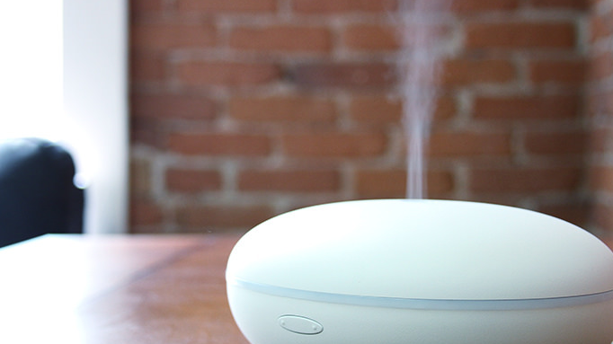
LONGER SCENARIOS – Scenario 2 (1 of 2)
The teacher will release a small amount of scented essential oils
When you smell the fragrance, write down the current value of the board timer
We will analyze the data as a function of distance and time
This Photo by Unknown Author is licensed under CC BY

Slide 13
LONGER SCENARIOS – Scenario 2 (2 of 2)
Recently, the CDC has recognized that air transmission via aerosols is the primary infection method. This has evolved prevention to center more on the wearing of masks rather than washing hands.
Science is a learning process and is not perfect. How does misunderstanding this reality lead to poor decisions?
Provide at least two examples of decisions people might make which do not support the common good.

Slide 14
Examples from History
Let’s investigate and discuss two historical examples for ethical and moral decision making.
Spanish flu of 1918
The AIDS epidemic in the 1980s
Take a few minutes to do an online investigation. Was the devastation of this disease due to a lack of knowledge or a moral failure?

Slide 15
Science informing Moral Decisions
We have worked to understand the common good.
We have seen how science and faith can work together to help us make ethical decisions.
We have gone through examples of how science has tried to guide us through the recent pandemic - even though our early understanding of the science might not be perfect.
Now we are going to give you a chance to work in a group on one final scenario using what you have learned.

Slide 16

Who Would You Save?
“Who should be saved during a flu outbreak when there is not enough life-saving vaccine available for everybody?“
Working with your small group...
complete the handout "Who Would You Save?"
prepare a slide or poster to present your decision to the class
You must support your decision with resources.
Your presentationshould also explain how your group came to your decision.
You will have 20 minutes to make your decision and prepare for your 1-2 minute presentation.

